Slide 1


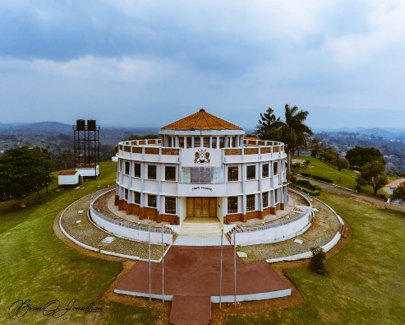
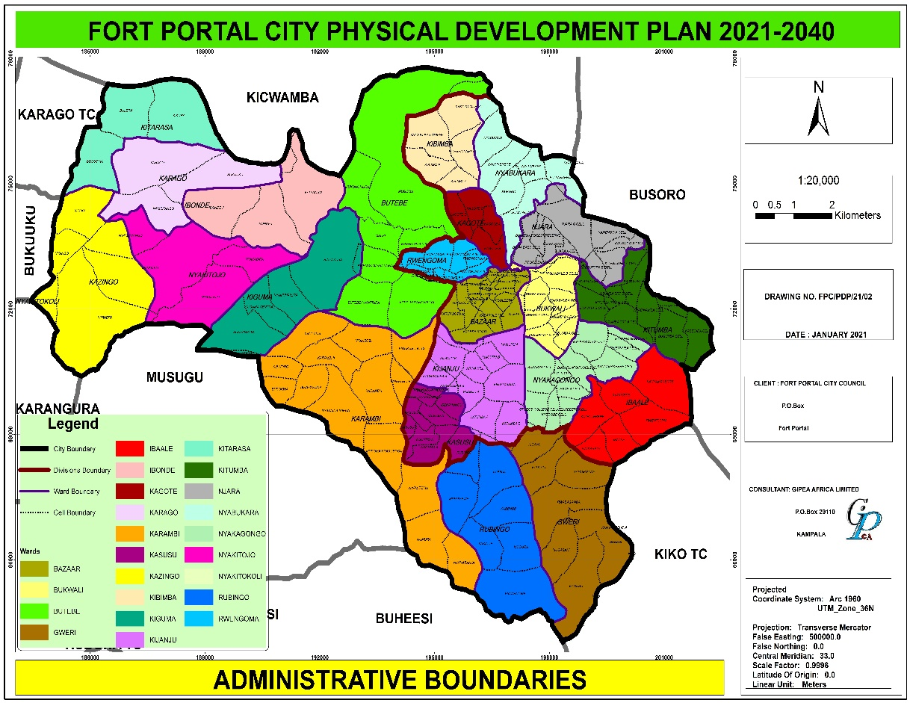
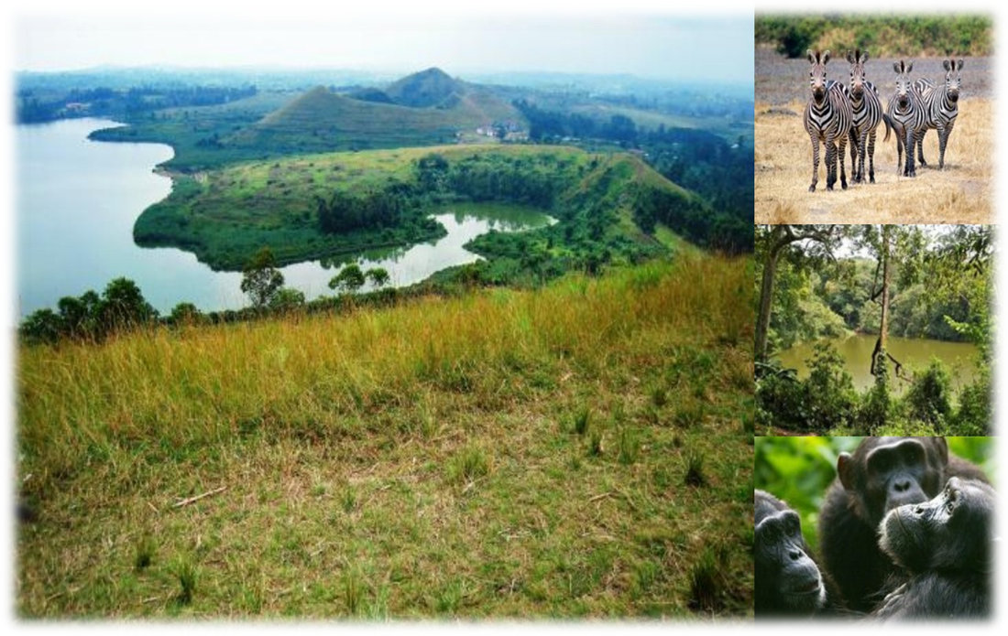
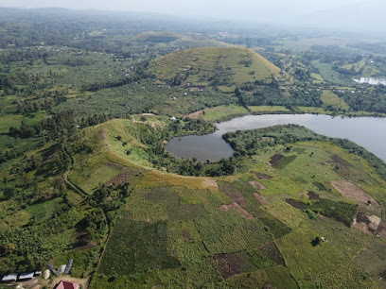

Kabarole District Local Government
Ministry of Lands Housing and Urban Development
Fort Portal City Physical Development Plan
2022 – 2040
Fort Portal Technical Planning Committee
GIPEA AFRICA LTD
Consultants in Geo-information, Physical Planning, Environmental Assessment, Local Governance and Development Planning
P.O.Box 29110 Kampala
Tel: 256772 – 522 – 861; E-mail: gipea.africaltd@gmail.com
Gayaza- Manyangwa Road Plot …..Room A1
21/January/ 2021

Slide 2
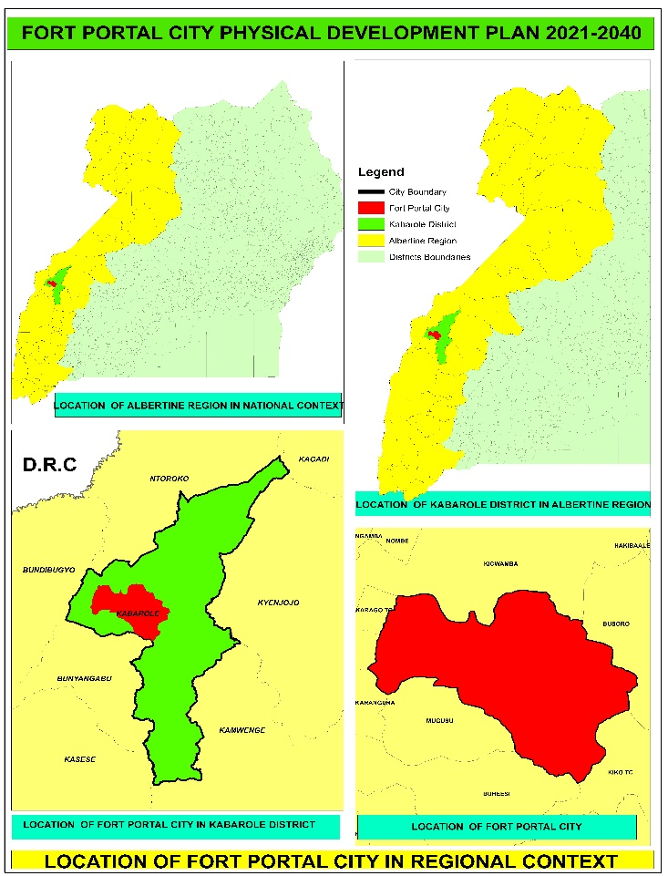

Location of Planning Area Regional context
Located about 316/320 km from Kampala via Mubende
Capital for Toro Kingdom
Situated at the foothills of the Rwenzori Mts
Bordered by Kiko TC (SE), Buhesi sub-county (south), Mugusu sub-county (south west), Karangura in (west), Kichwamba sub-county (north) and Busoro sub-county (northeast).
Map ; Fort Portal City Location and Administrative Structure

Slide 3
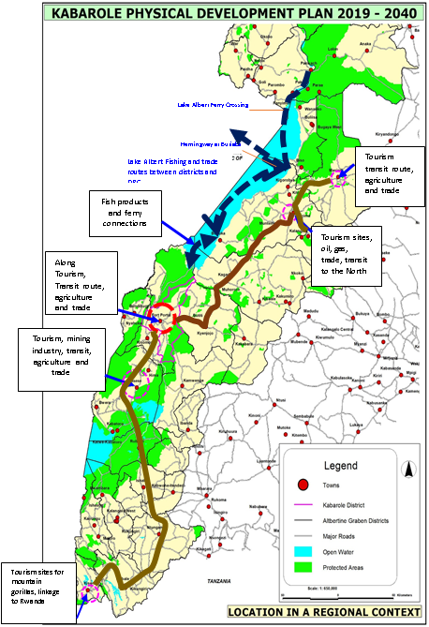
    Fort Portal City Comparative Advantage in the Region Context
Regional capital for the districts of mid western Uganda
Tourist hub for the Albertine Region - strategic tourist City
Strategic location along the tourism route and national ring road
Link to the major attraction areas of the Rwenzori Mountains, Kibale NP, Semuliki WLR, Itwara NFR, Queen Elizabeth NP, Bwindi NFR and other ecological zones
Agricultural potential (fertile soils and good climate)

Slide 4
Development Challenges
Fast population growth
Uncontrolled urbanization
Unplanned, unintegrated rural-urban systems
Unexploited tourism and agricultural potential.
Low capacity to plan and provide for ever growing demand for infrastructure, employment and services.
Degradation of environmental and natural resources
Prone to seismic activities and climate change
The area is water stressed
Justification for immediate interventions to reposition the City to tackle these challenges

Slide 5
Objective and SCOPE
Objective for the Assignment;
Prepare an integrated City Physical Development Plan (PDP) that will guide the orderly physical development of Fort Portal City for the next (18) years - through a participatory process
Defined scope
Publicity & mobilisation
Prepare Fort Portal City PDP
Visioning, setting strategic objectives,
Data collection, sectorial diagnostic & Strategic Analysis

Slide 6

Planning Area
Surface area of the City is 128.27sqkms
Population of the City was 74,555 as per 2014 Census
Two (2) administrative Divisions of Northern and Central
Twenty two (22) Wards
NB: need to confirm the city boundary by the client

Slide 7


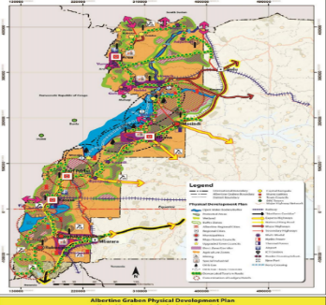
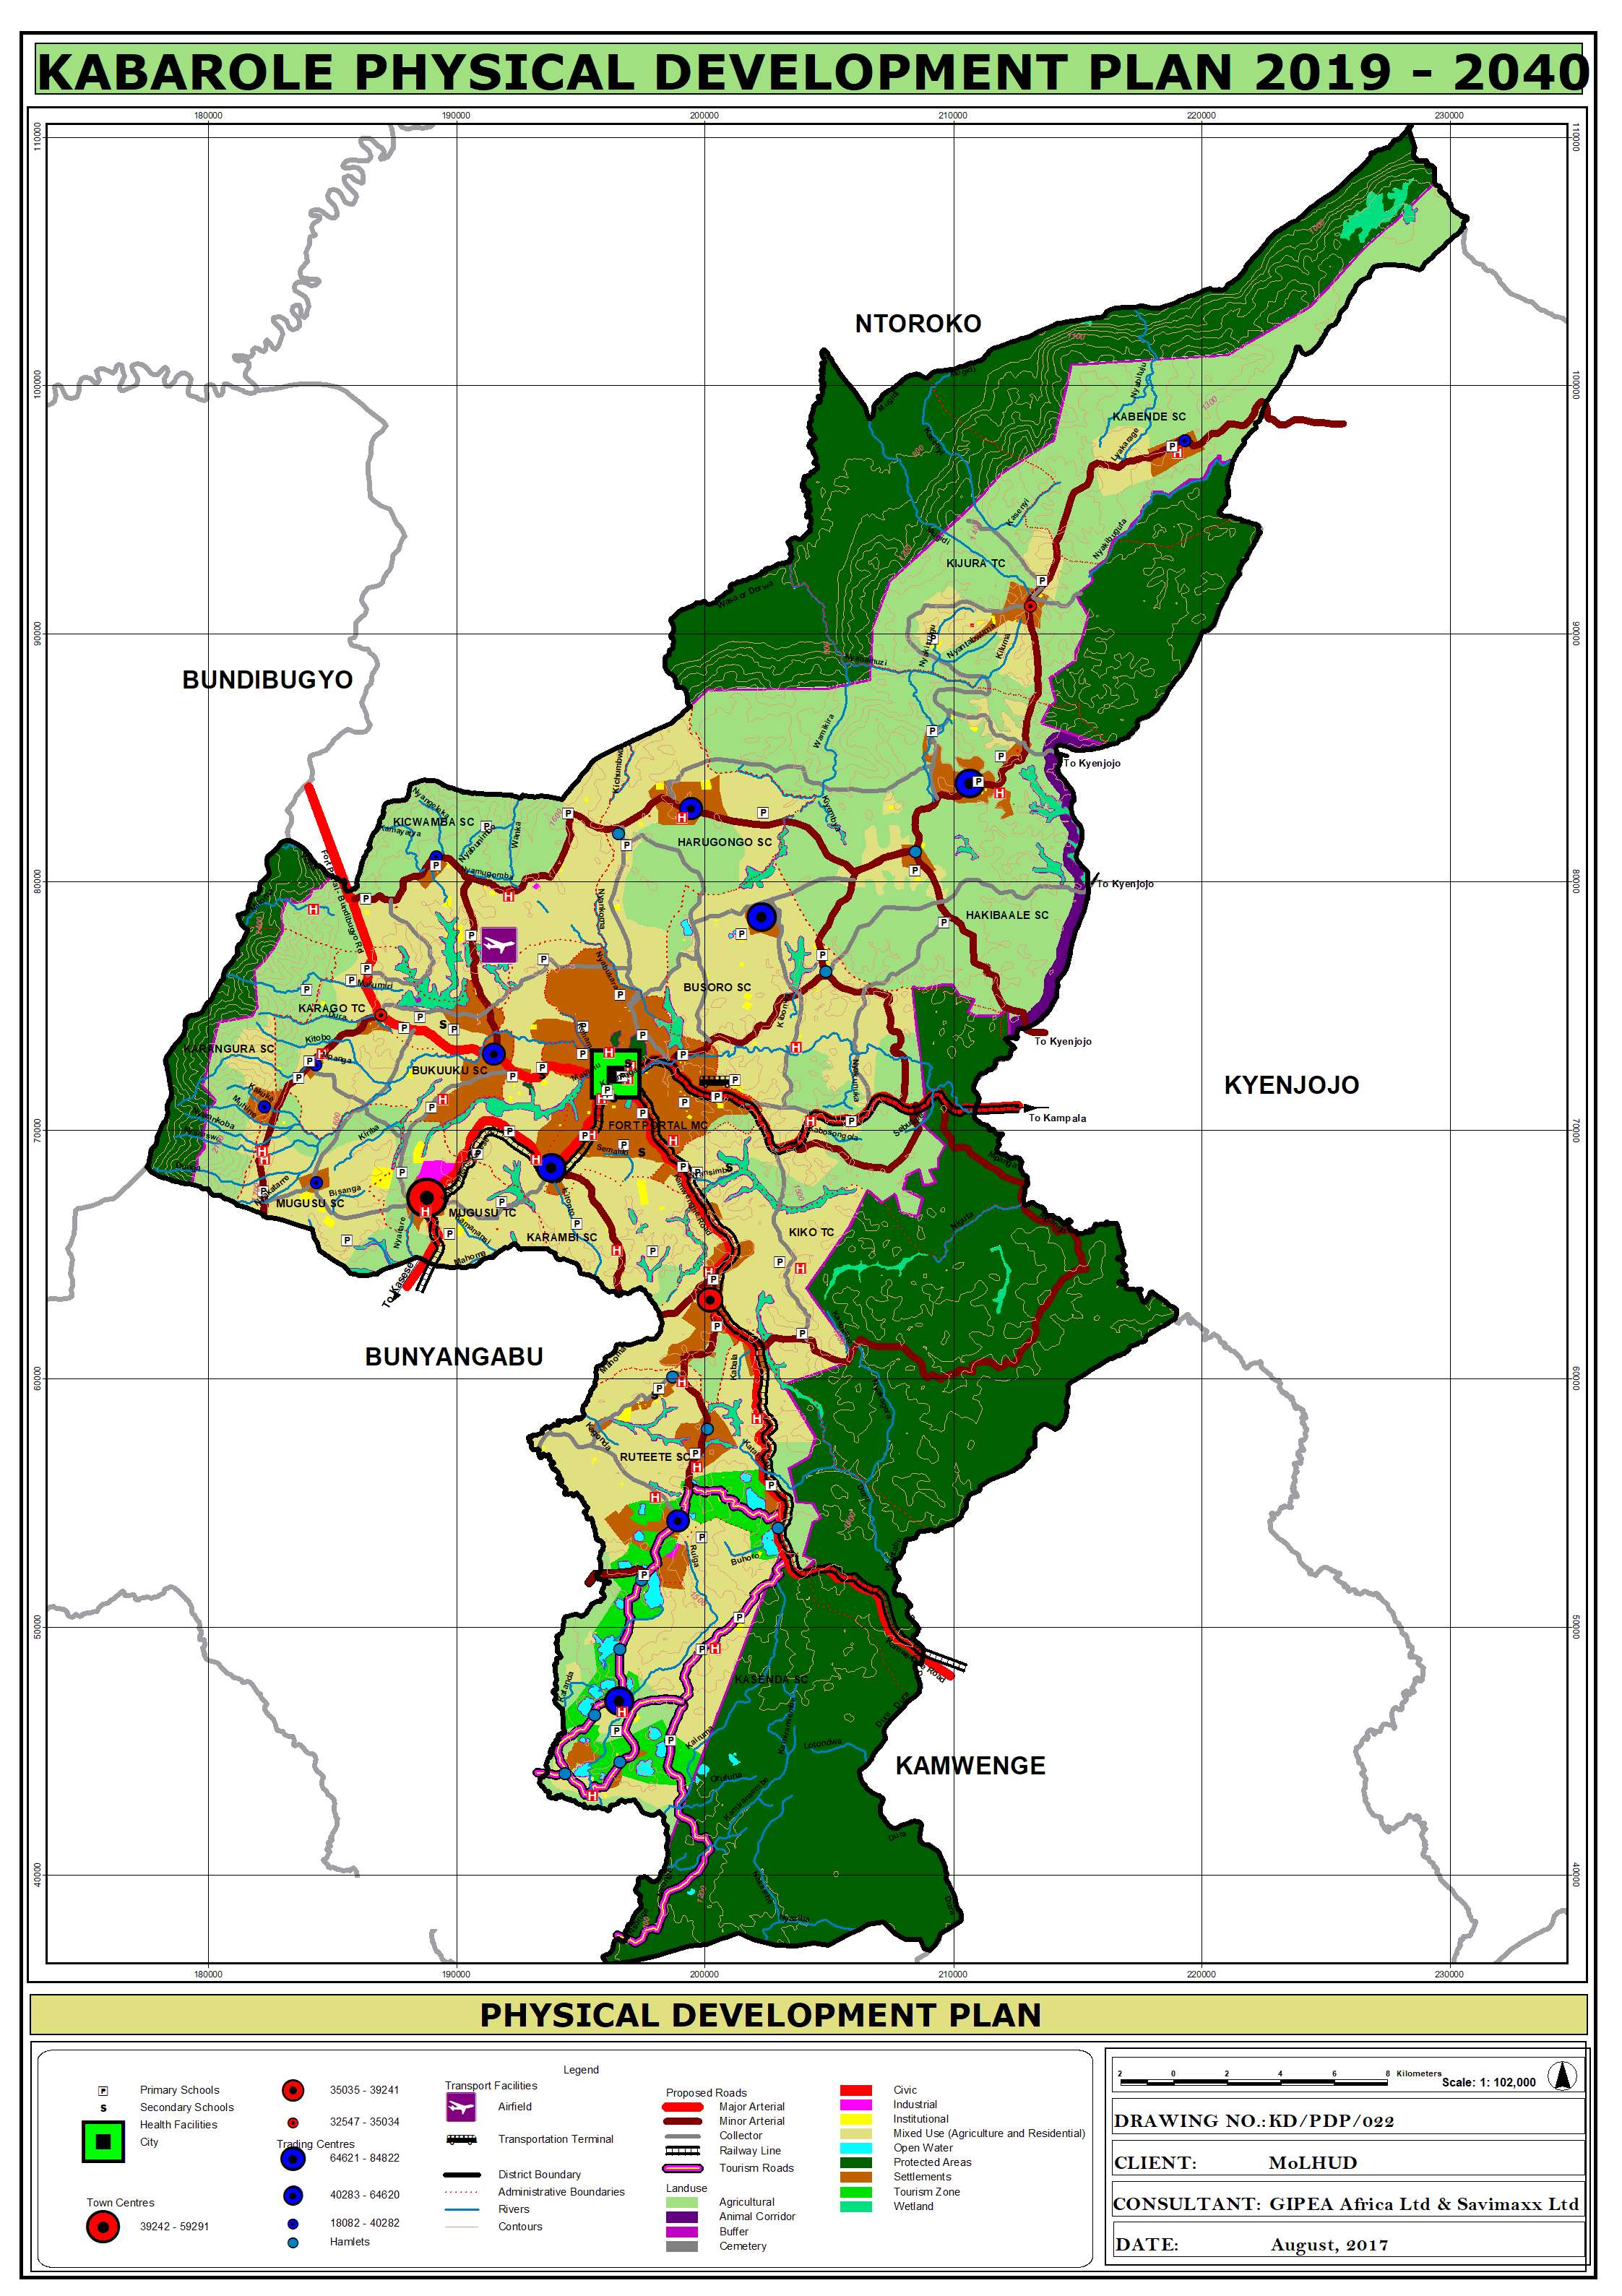
Policy Review and integration…
Aligned to National laws, policies and plans,
Laws, regulations, standards and ploicies
NDPIII + Sector Policies
City land use and sector development strategies
Aligned to Regional and District Framework
Translate and integrate
Albertine Region and
Kabarole District strategies
to City scale
Review provisions in existing plans:-
Urban PDP and Local Detailed Plans

Slide 8
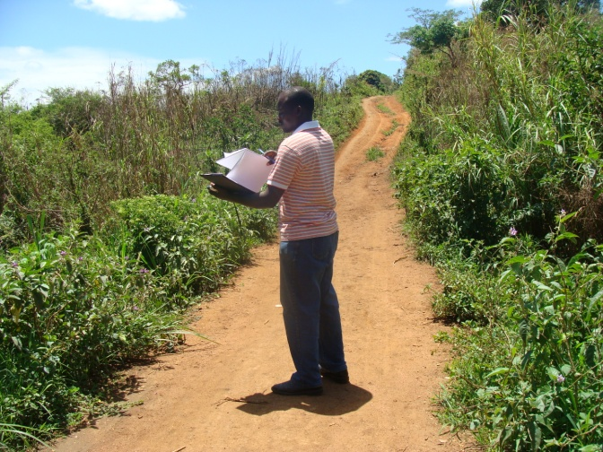
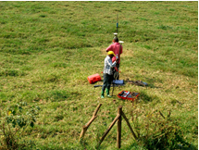
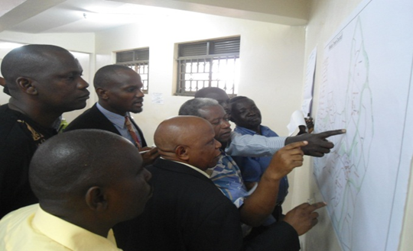
Field Surveys
Major activities will include
Household survey
Infrastructure and services mapping
Transect walks
Community mapping of City resources
Land use inventory
Aerial surveys (Drones)
Prepare base maps
Participatory mapping

Slide 9
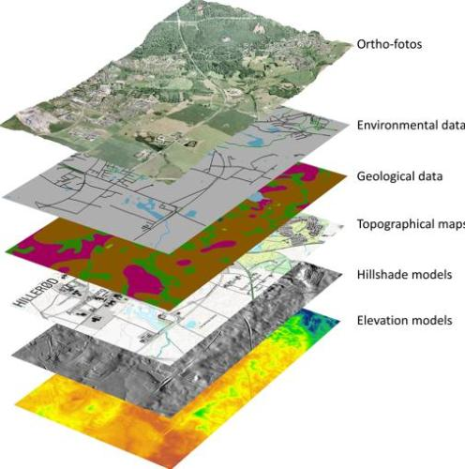
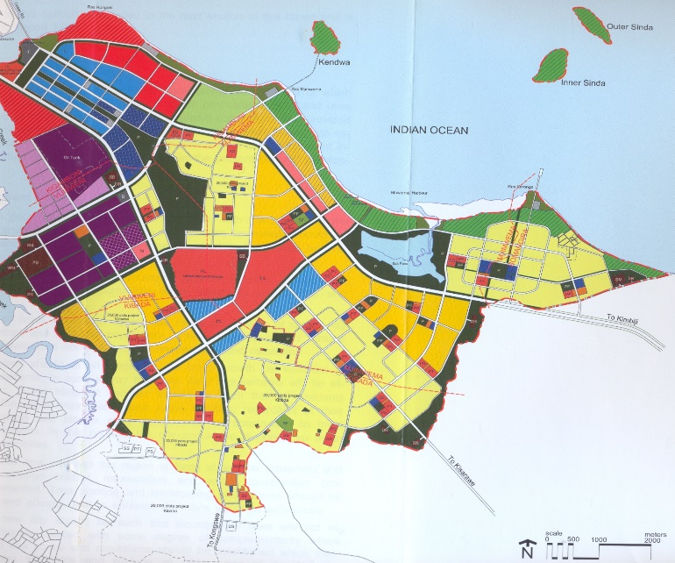
Data analysis and reporting
Sieve analysis of mapped themes and integration of the existing situation
SPSS package for analysis of socio-economic data
GIS software for spatial analyses and develop cartographic visualization and Remote sensing
Preparation of Thematic/Base Maps
Reporting, dissemination forums, presentations and discussions
Mapped themes
Etc.
Product

Slide 10

Ensure participation in formulating City Development Vision & popularize the plan
Mobilization, engagement of stakeholders and Publicity at City and Division, levels
Stakeholder Clustering for effective participation
Feedback meetings
Formulation of development Vision and Mission
Implementing the Information Education & Communication strategy
Desired Vision

Slide 11
Approval of City PDP
Present PDP to relevant stakeholders and Secure resolution
  Present to stakeholders (Division and City)
  Deposit Draft PDP for inputs (statutory 90 days)
  Integrate comments after lapse of deposit period
  Improve PDP
  Obtain Council/PPC resolution adopting new City PDP
Input of MoLUD technical Committee
Presentation of the PDP to the National Physical Planning Board for approval.

Slide 12
work plan
Project activity and Planned Task | Deliverable | Year | 2020 | 2021
 |  | Month | Dec | Jan | Feb | Mar | Apr | May | Jun | Jul | Aug | Sept | Oct | Nov | Dec
Inception meetings, reconnaissance, stakeholder engagement and reporting | Inception report
Data Collection and Analysis | Situation Analysis Report
Preparation of Draft PDP and Deposit | Draft PDP
Approval of Final PDP by NPPB | Approved PDP

Slide 13
  Emerging Issues requiring attention
Oversight from MoLHUD;
Input from the Client on Key Stakeholders consulted;
Client involvement in Public Awareness creation;
Inputs, Data, Services and Facilities to be provided by the Client;
  Protocol and Letters of introduction ;
  Copy of the City approved budget
  Existing and planned projects and plans;
  Office space during data collection
  Special areas that may require seeking permission to access
Need for City Urban Councils participation and contribution in implementation of the EIC strategy;
City Council staff Availability during the process;
Appointment letter of the project manager
Consent on the proposed plan time horizon (18 Yrs)

Slide 14
Way Forward
Client to develop engagement plan
Consultant to carryout mapping of services
Client to assist in identification of socio-economic data collectors
Client to mobilize FGD groups (market vendors, Boda boda, elderly, youth, PWDs, taxi and bus operators, women associations – 2 persons per category)
Client to identify and book meeting venues

